Slide 1

Complementary Factorization towards Outfit Compatibility Modeling
Tianyu Su Xuemeng Song∗ Na Zheng
ACM MM 2021
第9组
褚灵强 212050175 金涛 212050157 朱俊凯 212050234
Notes:
这篇的论文是基于互补因子分解 来进行outfit的Compatibility的建模

Slide 2

Background
Agenda
1
2
Main Idea
3
Methods and process
4
Results
Notes:
还是先讲一下简单的backgroud

Slide 3
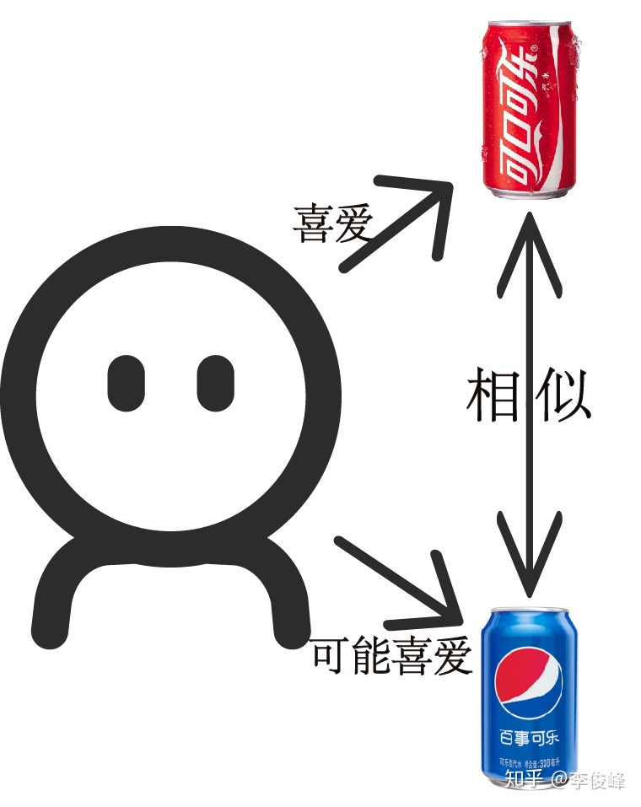
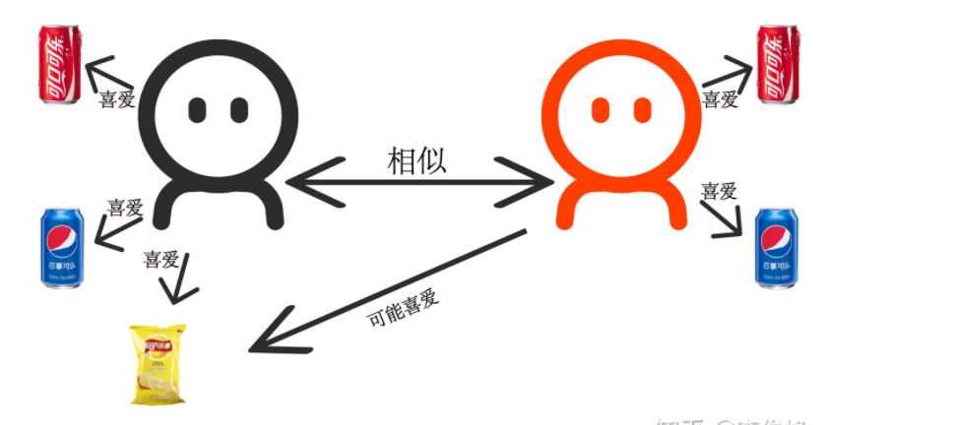
1. BackGroud
找相似的人
找相似的物

Slide 4
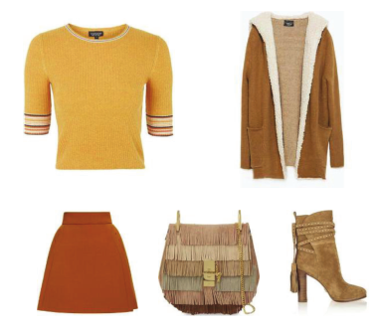
BackGroud
To make outfits recommendation, we have to generate embedding of outfits and evaluate compatibility of outfits.
For different outfits, we need to optimize the presentation of individual items based on context to better evaluate.

Slide 5
BackGroud
Pair-based methods：
1、 Overlook the hyper-relation and context relationship among multiple fashion items.
2、 The time complexity is O(n²)
sequence-based methods：
1、Take into account the item context.
2、Performance tends to be sensitive to the order of items.
graph-based methods：
1、Introduce graph neural networks (GNNs) into the outfit compatibility modeling.

Slide 6
2. Main Idea
Different from existing graph-based compatibility modeling methods focus on individual compatibility of each item ,directly target at the global outfit representation learning.
Evaluate the outfit compatibility based on multiple complementary hidden factors.
Use context-aware outfit representation model to fully explored item context.
Use hidden complementary factors modeling to uncovering the latent complementary factors with multiple parallel networks.
Notes:
关注整体 多因素

Slide 7
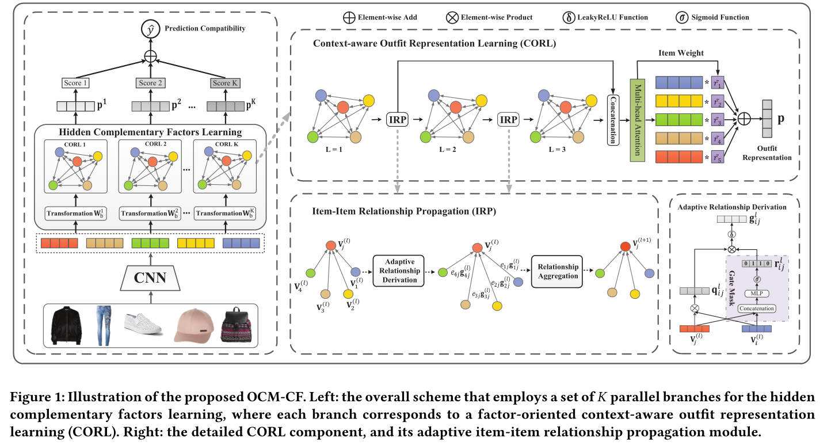
3. Methods and process

Slide 8
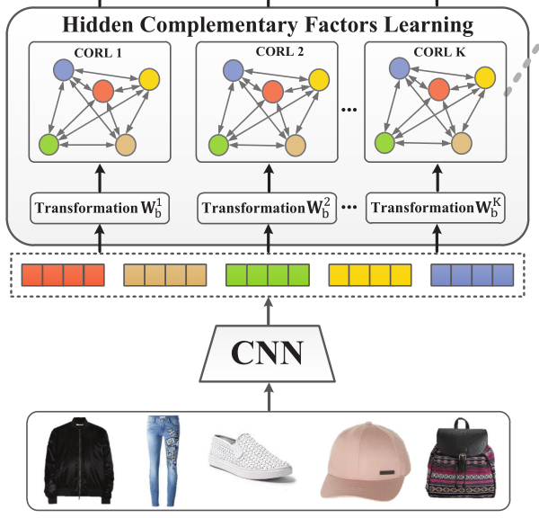

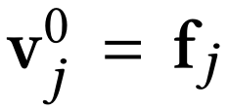

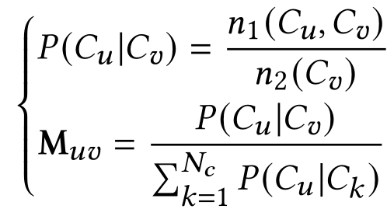

Hidden Complementary Factors Learning
CNN is 18-layer Deep Residual Network pretrained on ImageNet
L2 regularization is used to alleviate the overfitting.

Slide 9


Hidden Complementary Factors Learning
Notes:
我认为这篇文章一个的贡献是提出了这个loss，来防止并行网络的同质化

Slide 10
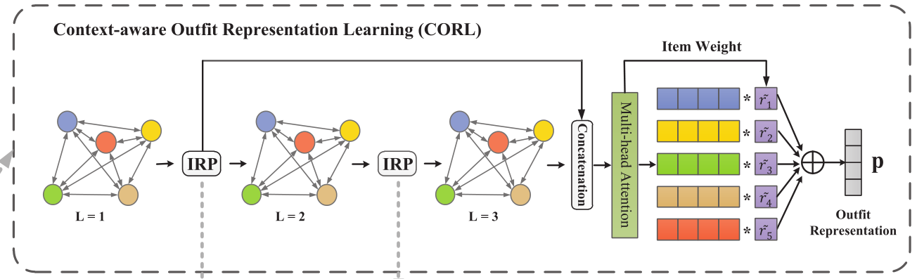
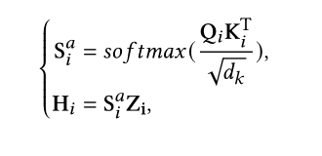

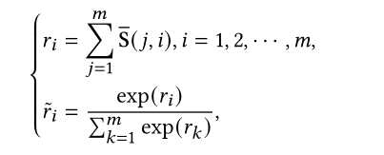
context-aware outfit representation model
attention weight matrix of the i-th head
the output of i-th head
Notes:
最后，为了避免在项-项关系传播过程中信息的丢失，我们引入了初始的可视化嵌入来定义最终的项嵌入

Slide 11
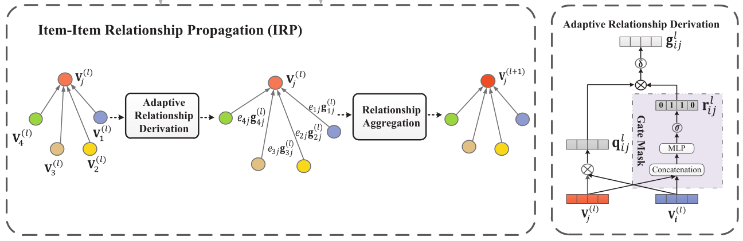
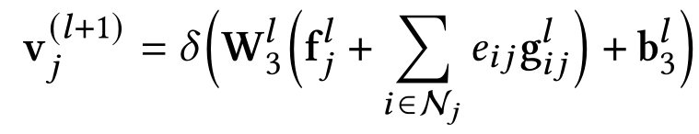
item-item relationship propagation module
Aggregate all the neighbor relationships to refine the ego item representation.

Slide 12
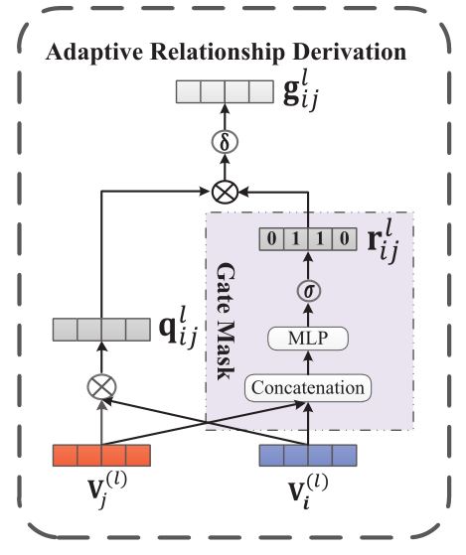




Adaptive Relationship Derivation
Use L1 regularization to enhance the sparsity of gate masks
Notes:
we argue that
different dimensions of the relationship embedding may contribute
differently to the compatibility modeling

Slide 13
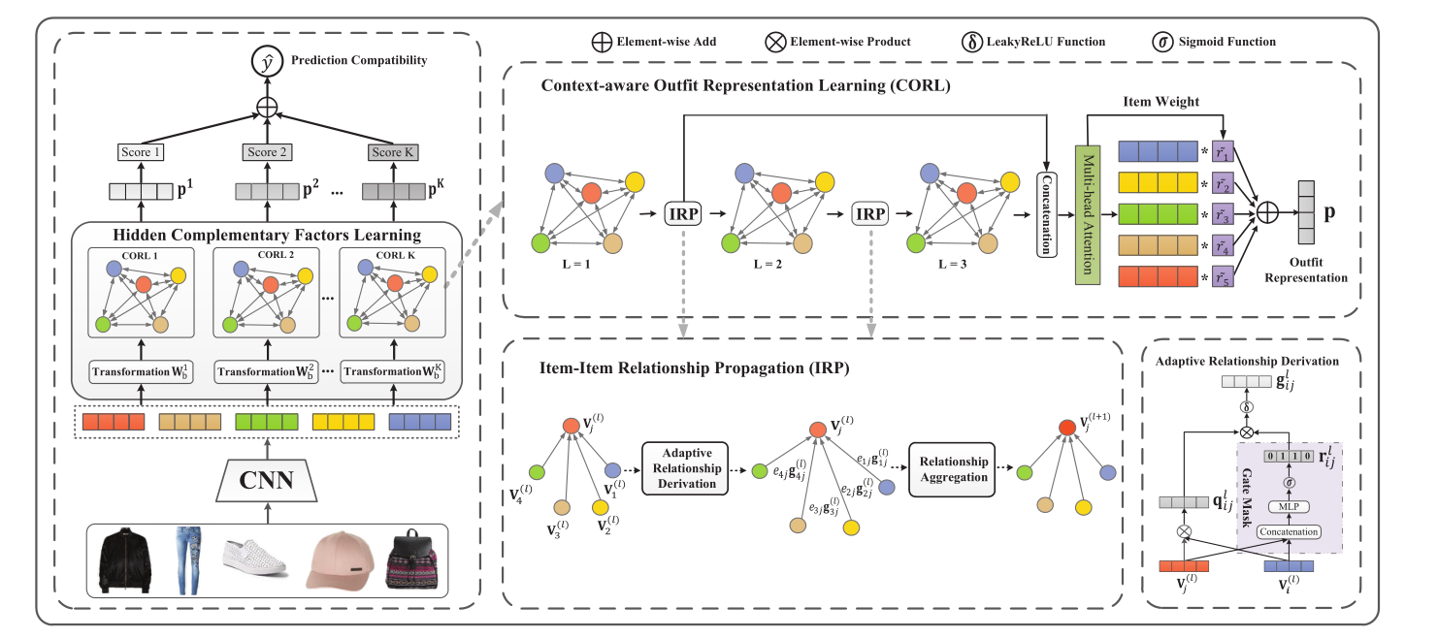
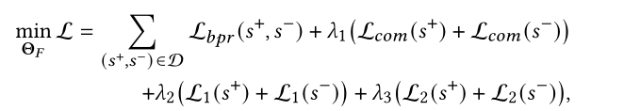
OCM-CF

Slide 14
Negative Outfit Composition
Manner1: randomly sample |s+| items from X without any restriction
Manner2: randomly sample |s+| items from X according to the item categories of s+
Manner3: randomly choose one item of the positive outfit and replace it with a randomly sampled item of the same category

Slide 15
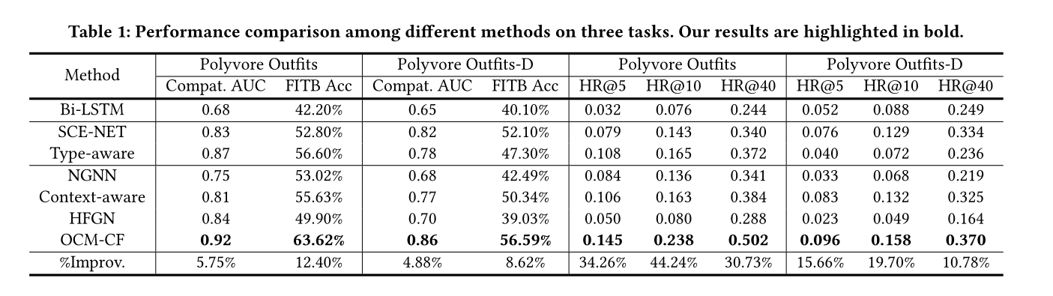
4. Results

Slide 16
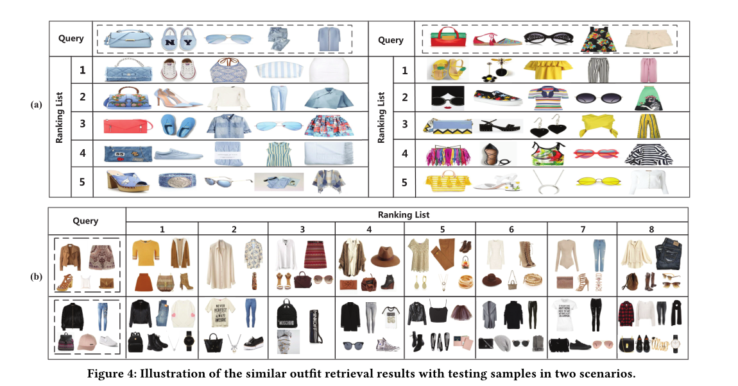
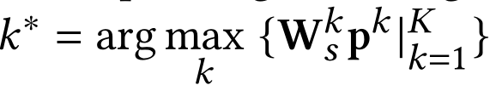
Similar Outfit Retrieval

Slide 17
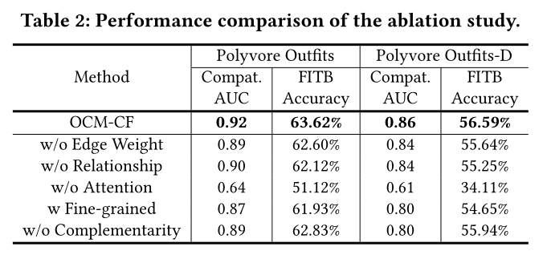
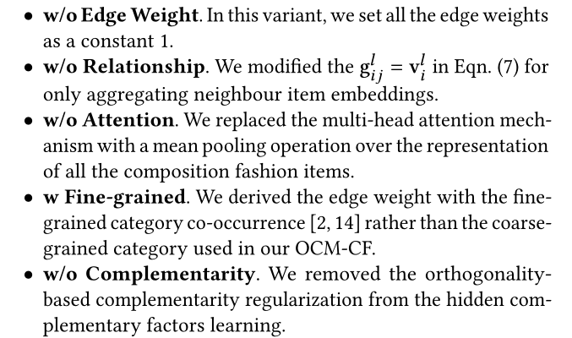
ablation study

Slide 18
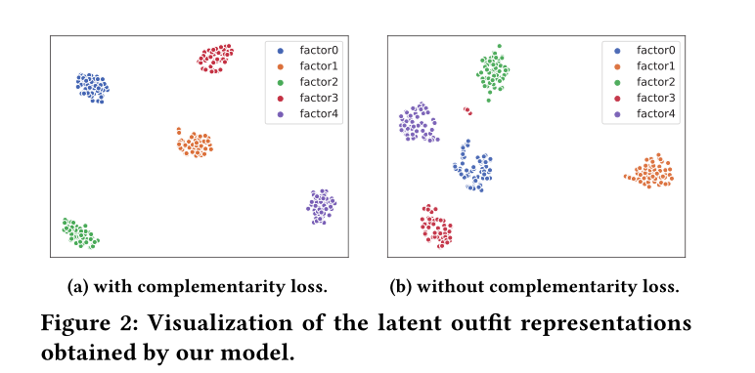
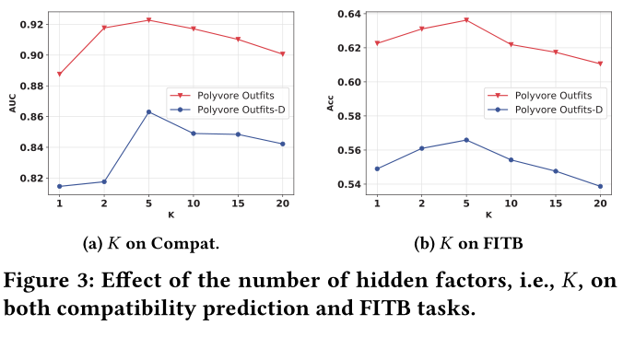
complementarity regularization

Slide 19
任务分工
褚灵强 212050175 文献阅读、讲ppt
金涛 212050157 文献阅读、优化ppt
朱俊凯 212050234 文献阅读、ppt制作

